Slide 1
Marcmira Innovative’s Network
A Showcase of our Network Construction Abilities

Slide 2
construct a network to connect two branches each having three departments and having an admin office.
Requirement

Slide 3
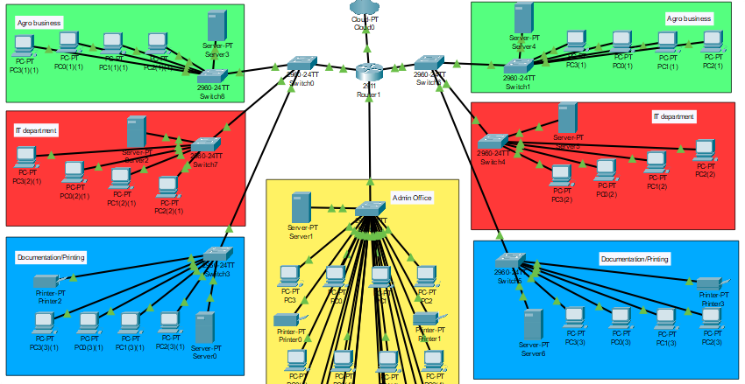
Diagram of the network
We used CISCO Packet Tracer to prototype this and ensure that it was of to use for construction.
We are basically using:
PCs to represent endpoint devices
servers,
printers,
switches,
a router,
cloud to represent an ISP and
wires to represent connections.

Slide 4
Expectations
Each computer can communicate with the server and other computers within their departments but cannot communicate anything in the other departments.
The admin office can monitor every communication and every computer within the network.
Everyone on the network has access to the internet.
Everyone is protected by firewalls configured on the servers.
The documentation/printing department and the admin office have printers.

Slide 5
DHCP Server and client Conf. FIREWALL DNS VLAN and Trunk Port
Configurations done

Slide 6
Special Notes
Dynamic Host Configuration Protocol (DHCP) helps devices to automatically get IP (Internet Protocol) addresses. Communication can not occur without an address.
A virtual local area network (VLAN) permits only the computers connected to it to communicate. It is configured on some switches.
A trunk port comes in to allow special devices like a router or parent switch to access communications from all the VLANs on the switch.
Domain Naming Services (DNS) is a method of assigning a domain name to an IP address. It can also be assigned to ports of the identified device.
Firewall is a set of rules which defines what is allowed on the network and what is denied on a network. Its main objective is to block attackers.

Slide 7
Thank you for your Attention
The End.

